Slide 1
Fees Impact on
Member’s Lifetime Value
Candy Care Share Case Study
- by Charles Zhang

Slide 2
Agenda
1. Analysis Background
2. Scope & Assumptions
3. Trip Data Exploration
4. Member’s Trip Trend Analysis
5. Fee Impact Conclusion
6. Recommendations

Slide 3
Background
Context
In March, there were 804 members charged once with violation fees, under different reasons and amount.
Some members were fully refunded, some members were partially refunded, while others paid in full.
Objective
Candy Car Share wants to understand:
How may violation fees impact member’s life-time value?
How may Candy Car Share optimize fee policy to avoid negative impact?
- Stop charging - Reduce amount - Waive processing fee - No change

Slide 4
Scope & Assumptions
Scope
This analysis focuses on optimizing fees amount and does not consider stopping charging.
This analysis focuses on “Tow Fee” as it accounts for 75% violation cases and brings significant cost to Candy Car Share ($215 per case).
Assumptions
Members analyzed were only charged once in March, not before or after.
Trip pricing doesn’t change for users who got charged.
Members who were fully refunded wouldn’t change their usage pattern because of the charging.
It is against Candy Car Share’s policy to set different charging rules based on member’s age.

Slide 5
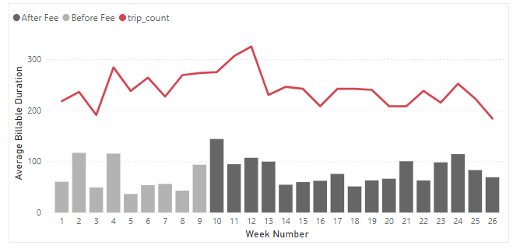
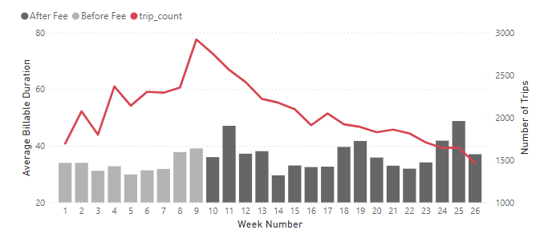
Trip Data Exploration
Fully Refunded Members
Charged Members
Compared with fully refunded members, total trips for charged members shows clearly decline. In comparison, average billable duration for both groups shows similar trend
Conclusion: fees mainly impact usage frequency, not usage duration

Slide 6
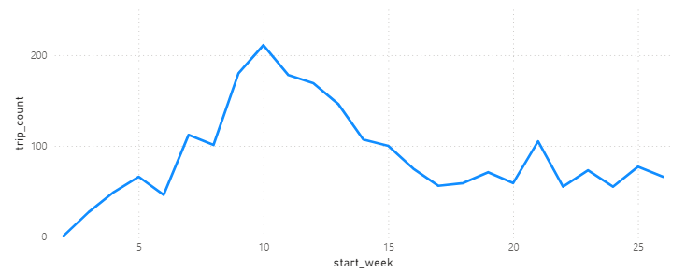
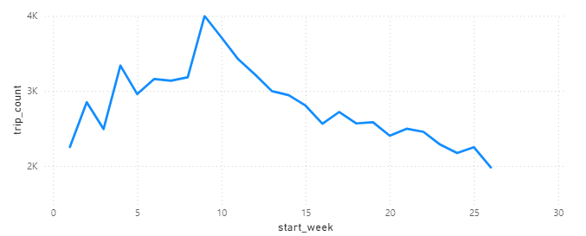
Total Trips Trend by Membership Duration
New Members (< 1 year)
Avg. Fee Amt: $289
Loyal Members (>= 1 year)
Avg. Fee Amt: $270
Fees amount for new and loyal members has no significant difference (p-value = 0.39)
For both new and loyal members, total trips has shown similar declining trend, though for loyal member the decline persists longer.
Conclusion: fee impact on new members is no greater than loyal members, and therefore there is no need set different policies based on membership duration.

Slide 7



Membership Segmentation
Non-Frequent Members
(<= 1 trip per week)
Regular Members
(2-3 trips per week)
Frequent Members
(>3 trips per week)
Sarah: a college student doesn’t own a car yet. Need ride share on occasional weekend gateway
Mike: an IT professional with 3 days at office. Need carshare for regular commute
Amy: a B2B sales manager needs carshare for regular client meetings.

Slide 8
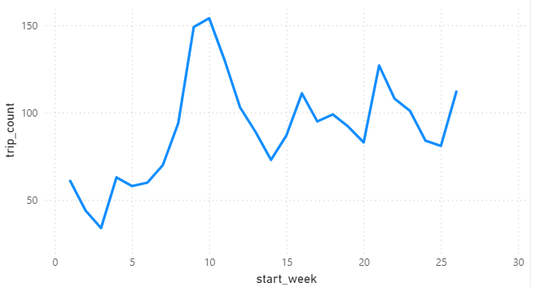
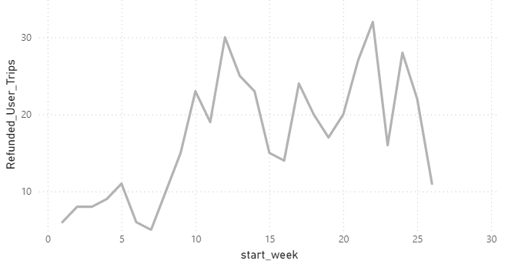
Trips Trend for Non-frequent Members
Total trips for Charged Members
Total trips for Refunded Members
For non-frequent members, those who were charged show significant sharper decline in total trips than their refunded counterpart.

Slide 9
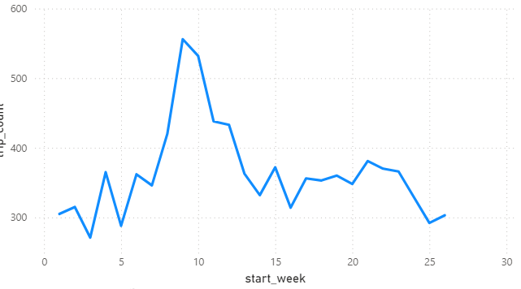
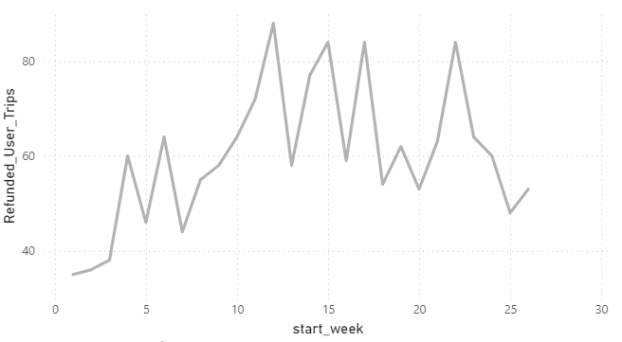
Trips Trend for Regular Members
Total trips for Charged Members
Total trips for Refunded Members
For regular members, those who were charged also show significant sharper decline in total trips than their refunded counterpart.

Slide 10
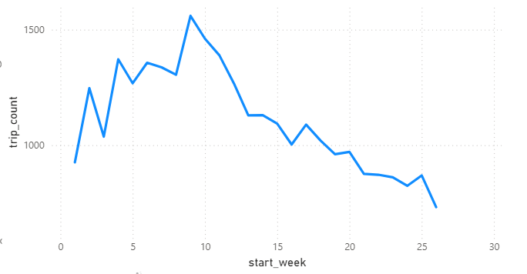
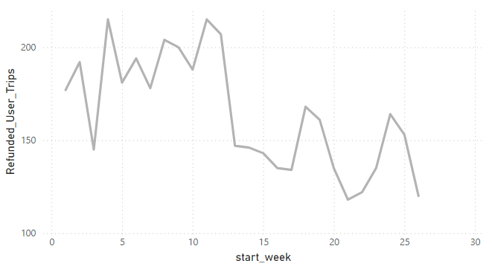
Trips Trend for Frequent Members
Total trips for Charged Members
Total trips for Refunded Members
For frequent members, both charged and refunded users show similar decline trend in total trips.

Slide 11
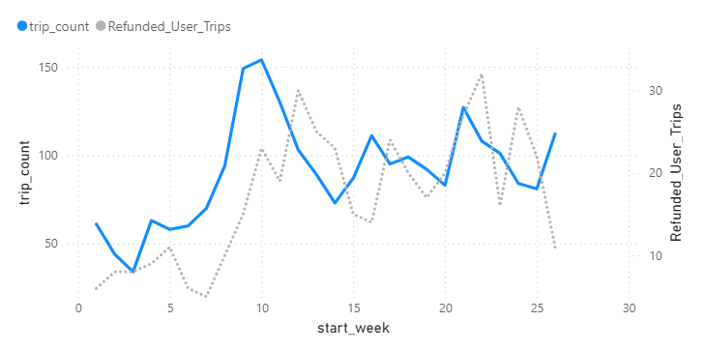
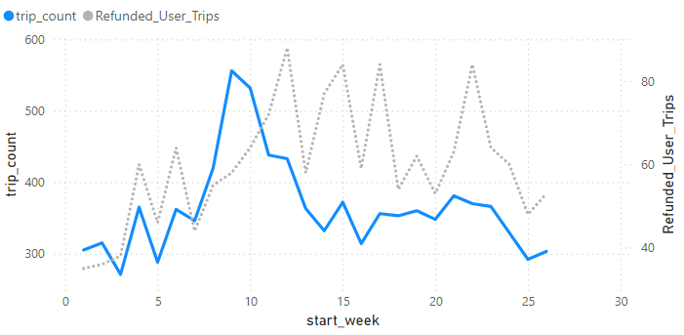
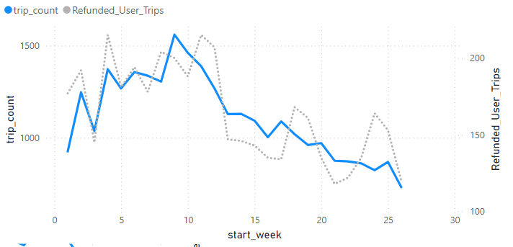
Trips Trend Review
Non-Frequent Members
Normal Members
Frequent Members
The fee impact has been mostly reflected on members with less usage (weekly trips <=3).
It is likely because these members don’t have inelastic demand for ride share, and therefore are more sensitive to fee charge.

Slide 12
Chi-square Test on Churn Rate
Purpose: to understand if charging leads to significantly higher churn rate
Frequent Members
Non-Frequent Members
Normal Members
 | Before Charge | After Charge
Charged | 194 | 159
Refunded | 29 | 24
 | Before Charge | After Charge
Charged | 242 | 228
Refunded | 29 | 29
 | Before Charge | After Charge
Charged | 278 | 273
Refunded | 30 | 30
P-value: 0.97 (not significant)
P-value: 0.83 (not significant)
P-value: 0.98 (not significant)
Based on chi-square test, no membership group shows significant higher churn rate for charged members.

Slide 13
Impact Analysis Conclusion
The fee impact has been mostly reflected on members with less usage (weekly trips <=3).
The reduced usage is mostly coming from less usage rather than completely loss of members.
Estimated weekly trip decline %
Non-frequent Members: 17%
Regular Members: 25%

Slide 14
Impact Comparison by Fee Amount
Conducted Mann–Whitney U test to compare avg weekly trip decline by different fee amount
 | Control Group (Fully refund) | $251-300 | $301-350 | $351-400 | Partially Refunded | $114 (Spilled Hot Chocolate)
Weekly Trip Decline (median) | 7% | 22% | 28% | 34% | 30% | 9%
P-Value (is the decline significant) |  | <0.05 | <0.05 | <0.05 | < 0.05 | 0.15
Conclusion: Members who were charged with Tow Fee, regardless of fee amount or if partially refunded with processing fee, all show significant weekly trip decline.
In contrast, members who were charged with $114 for “Spilled Hot Chocolate” doesn’t show statistically significant larger decline.

Slide 15
Recommendations
Set tow fee charge at $150 for non-frequent and regular members to avoid negative impact on their usage pattern.
For frequent members, from given data there is no strong evidence for supporting fee change.
we need to explore other reasons that cause the trip decline such as seasonality, promotion, and pricing.

Slide 16
Additional Analysis Suggested
With additional data on historical trips and data about promotion activities, we can further examine how seasonality, promotion, pricing could impact members’ usage, and build a regression model to quantify charge’s impact.
With trip data of users without being charged, we can conduct more robust statistical testing by both member’s usage frequency and fee amount.

Slide 17
Limitation
Due to the size of fully-refunded user is too small, we couldn’t conduct robust statistic testing by both different member groups and fee amount. Hence, we assume the fee amount impact doesn’t change by member group.
This analysis excluded trips that are cancelled as we assume trip cancellation is not related to fee impact.

